Slide 1
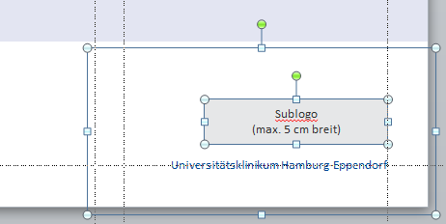
Journal Club
Research
Die Möglichkeit, ein Sublogo zu platzieren, haben Sie auch auf den anderen Titelseiten-Layouts.
Markieren Sie sich hierzu alle Elemente in der unteren rechten Ecke und kopieren Sie sie mit STRG+C.
Gehen Sie auf eines der anderen Titel-Layouts und drücken Sie STRG+V, um die Elemente an gleicher Stelle einzufügen.
Markieren Sie dann das rote Hinweisfeld an der oberen rechten Ecke und löschen es.
(Maximilian Schulz | 07.10.2021)
Universitätsklinikum Hamburg-Eppendorf

Slide 2
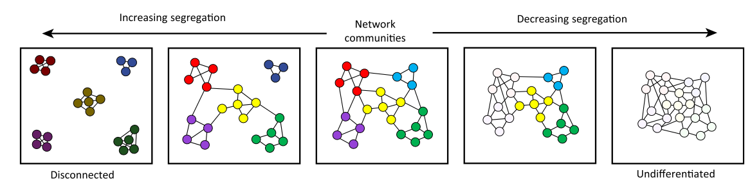
Functional connectivity between modules is better preserved as a function of age than within-module connectivity
particularly for modules in association cortex and more prominent for individuals over 50 years of (Chong et al. 2019, Chan et al. 2014)
Functional modules become less distinct or separate with increasing age, expressed in graph theoretical terms as decreased modularity and system segregation, based on measures of within-module and between-module connectivity (Bagarinao et al., 2019; Betzel et al., 2014)
Graph theoretical investigations of resting-state FC support concept of age-related neural dedifferentiation, the idea that aging is associated with a decline in the specialization or separation of functional neural modules (Geerligs et al., 2014)
While greater resting-state system segregation is associated with superior cognitive ability, effective task performance is best accomplished by a reduction in segregation, or greater integration, of the task-relevant systems that support the processing goals of the task.

Slide 3
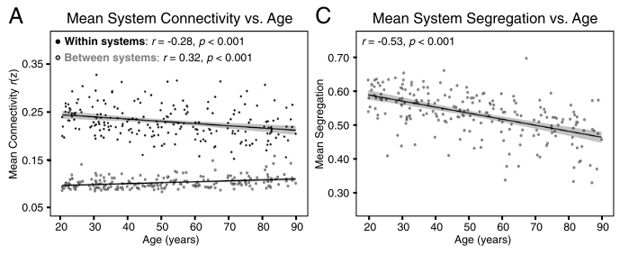
Nodes with direct structural connections exhibit little age-related change in functional connectivity, nodes with less efficient structural connections were more likely to exhibit an age-related increase in FC (Betzel et al. (2014)
Age-related decrease in functional system segregation may be a result of decreased structural efficiency, with functional connections between structurally disconnected regions relying on indirect paths (Madden et al. 2020)
Hypothesis: Functional connectivity is disrupted through degenerated direct white matter path, but could be preserved by indirect pathways which might involve more regions from different functional networks leading to less segregation

Slide 4
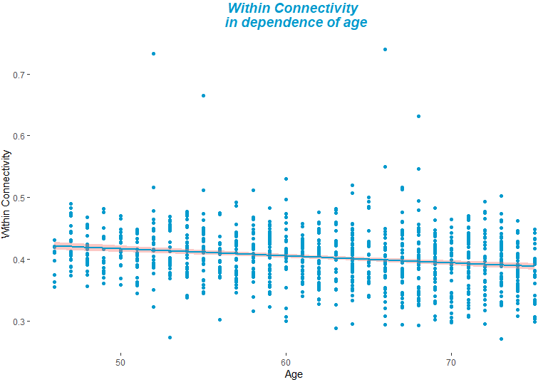
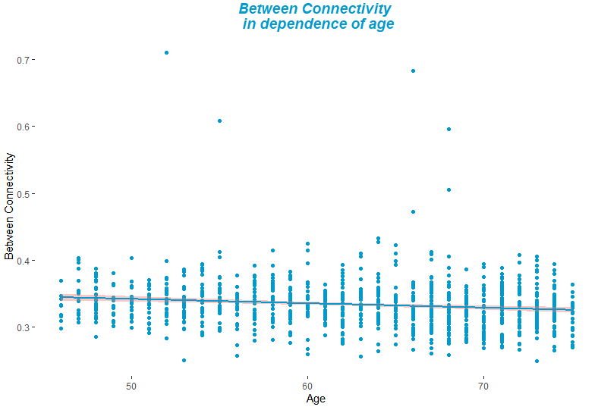
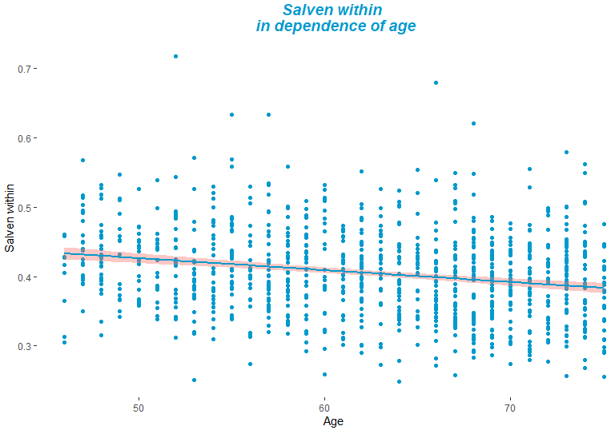
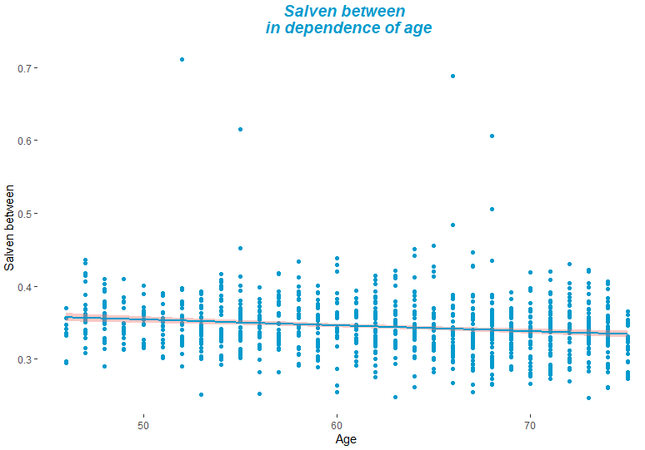
Global within : r = - 0.21 r² = 0.043 p < 0.001
Global between : r = - 0.15 r² = 0.02 p < 0.001
Salience within : r = - 0.23 r² = 0.051 p < 0.001
Salience between : r = - 0.16 r² = 0.027 p < 0.001

Slide 5
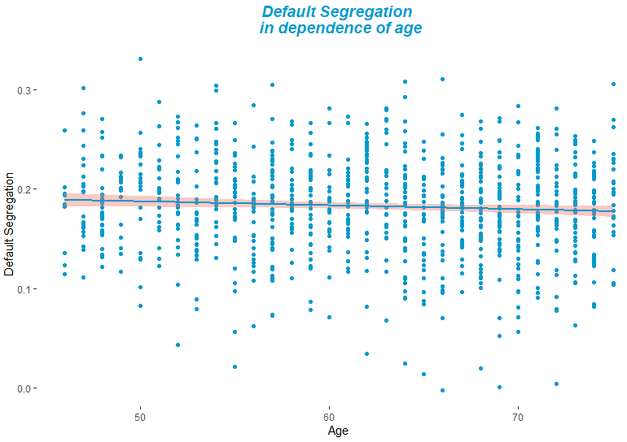
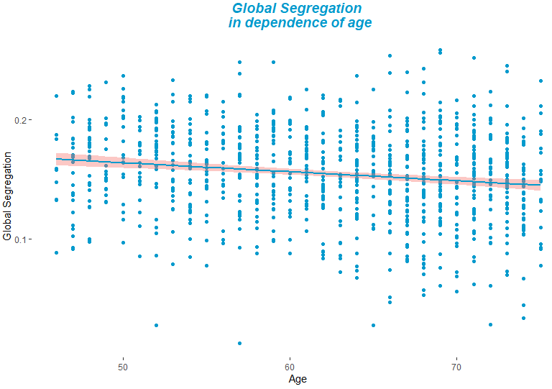
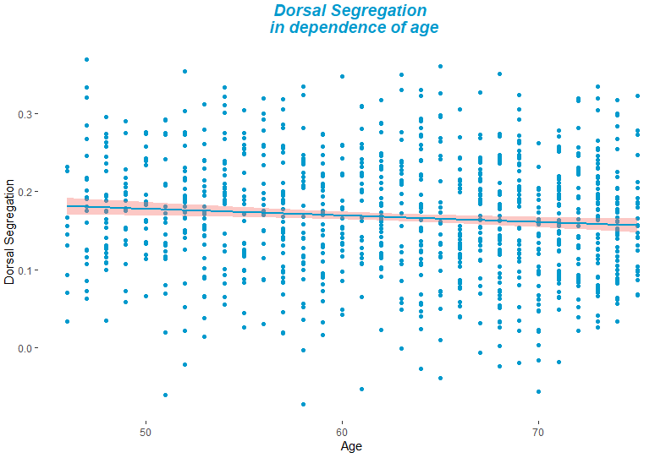
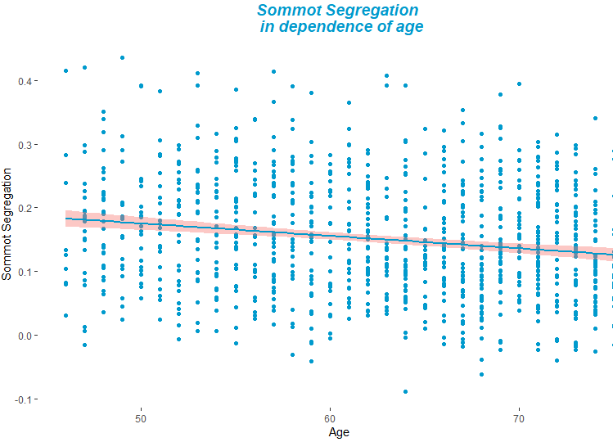
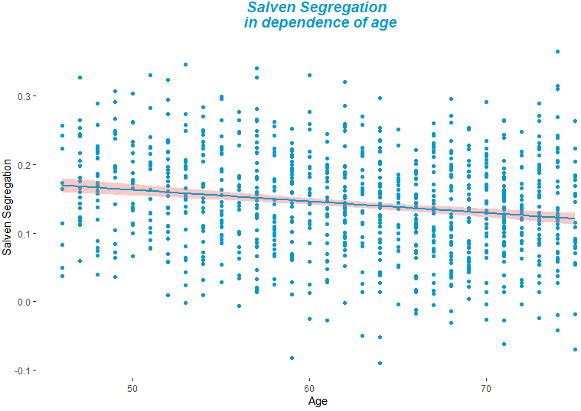
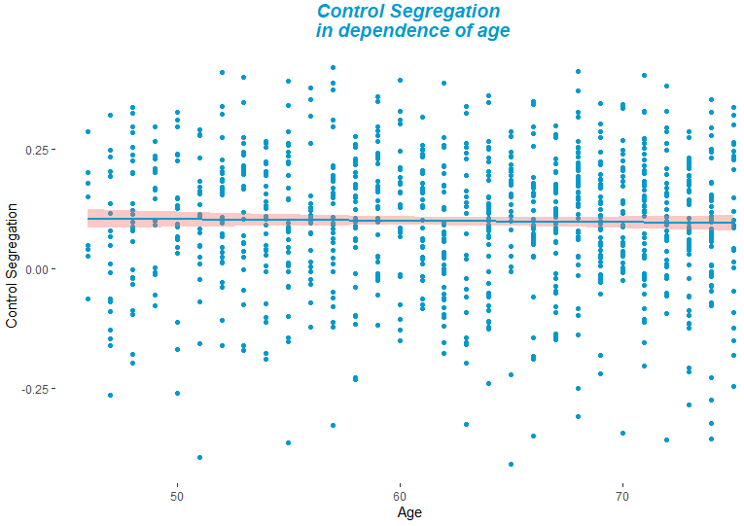
HCHS
Default: r = - 16 r² = 0.025 p = 0.07
Dorsal: r = - 0.14 r² = 0.02 p = 0.009
Global: r = - 0.16 r² = 0.027 p < 0.001
Salience: r = - 0.2 r² = 0.036 p <0.001
SomMot: r = - 0.22 r² = 0.05 p <0.001
Control: r = - 0.04 r² = 0.0013 p = 0.55

Slide 6
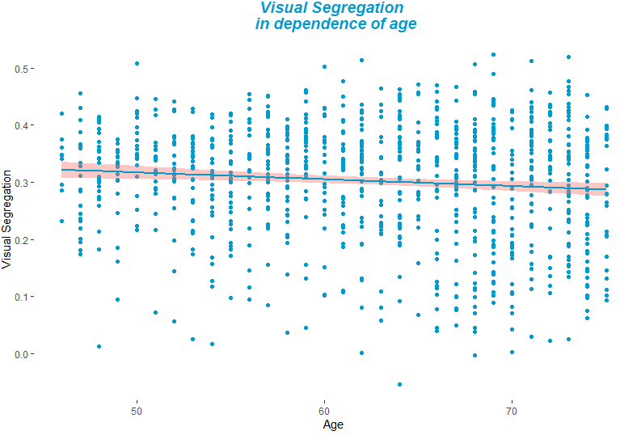
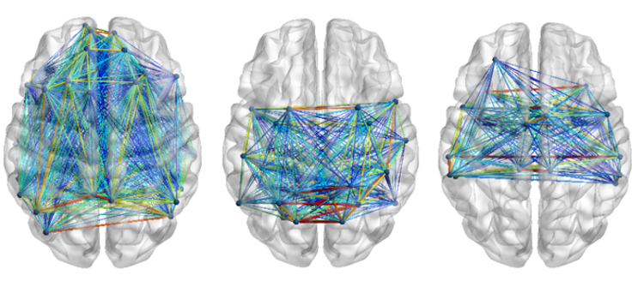
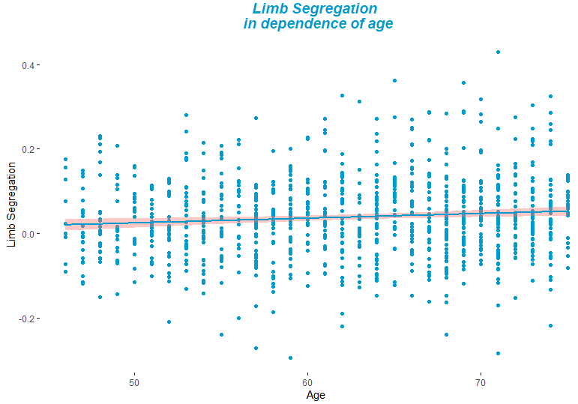
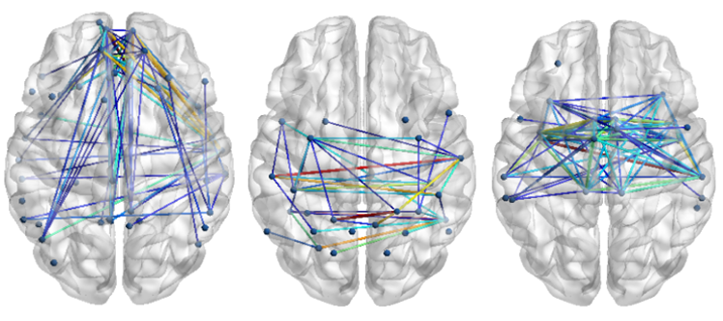
HCHS
Visual: r = - 0.1 r² = 0.01 p = 0.002
Structural connectivity of resting state networks
Limb: r = 0.09 r² = 0.08 p = 0.003
Structural subnetworks that change with age

Slide 7
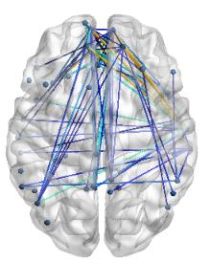
Global structural connectivity
Every structural subnetwork alone
Structural connectivity of sensory networks
Structural connectivity of association networks
a*b
Structural Subnetwork
a
b
Functional Segregation
Age
c
Global functional segregation
Functional segregation of resting state network
Functional segregation of sensory networks
Functional segregation of association networks

Slide 8
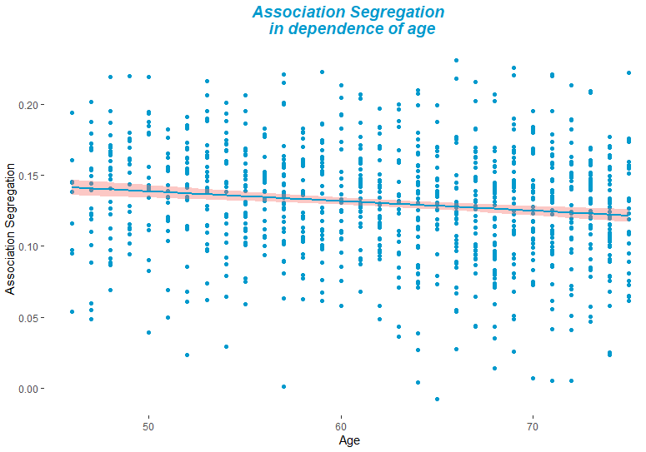
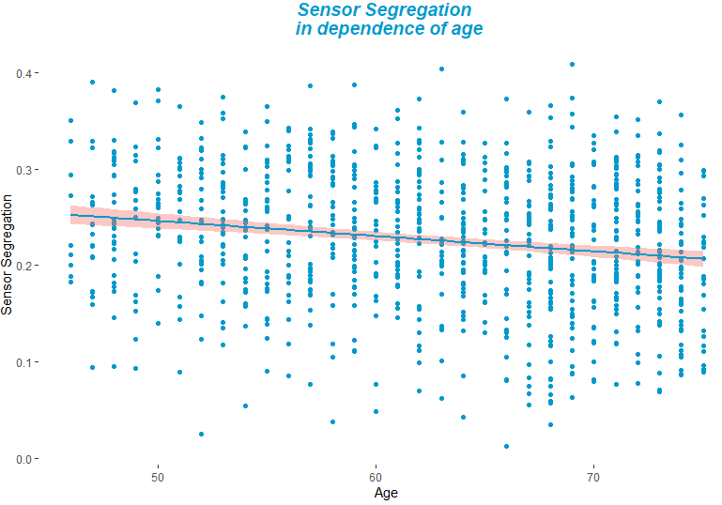
Association Segregation: r = - 0.15 r² = 0.02 p < 0.001
Default mode network
Dorsal attention network
Salience Ventral network
Control network
Limbic system
Sensory Segregation: r = - 0.21 r² = 0.044 p < 0.001
SoMot network
Visaul network

Slide 9
Connector node: a node that exhibits a relatively large proportion of connections that are distributed across nodes in communities other than its own; connector nodes can be hubs
Connector nodes often facilitate interaction between the segregated communities of a network
In healthy young adult brains, nodes with RSFC-defined connections that span multiple brain systems (i.e., globally defined connector nodes) are engaged across a wide range of tasks.
The diverse connectivity of these connector nodes likely mediates a broader repertoire of function and/or allows them to flexibly integrate and transfer information between distinct functional systems.
However, the connector versus non-connector distinctions in both patterns of connectivity and task-related activity are diminished in brain networks that exhibit less system segregation
Damage inflicted at connector nodes, or locations that are hypothesized to serve a central role in the integration across distinct brain systems (i.e., hubs), has been shown to decrease measures of RSFC network segregation and also result in widespread cognitive deficits

Slide 10
Indicate that sudden or progressive damage to the brain, especially when inflicted at crucial connector or hub locations, is associated with increased RSFC between systems, or decreased segregation. The observation of de-segregation of resting-state functional networks contrasts with descriptions that highlight the disconnection of anatomical networks (i.e., white matter bundles) in relation to both disease and age-related cognitive decline

Slide 11
Klinik, Institut, Geschäftsbereich
Martinistraße 52 | D-20246 Hamburg
Ansprechpartner
Telefon +49 (0) 15202781606 m.schulz1@uke.de | www.uke.de

